Slide 1
Data Processing Model to Perform Big Data Analytics in Hybrid Infrastructures
Team Members:
Anil Varikuppala
Vivek Reddy Suresh Puttireddy
Pavan Sai Kumar Jalluri
Om Sai Kumar Vaddi
Date: 7/23/2024

Slide 2
Introduction to the Team
Anil Varikuppala: Research and Literature Review Specialist
Vivek Reddy Suresh Puttireddy: Algorithm Development Expert
Pavan Sai Kumar Jalluri: Project Leader
Om Sai Kumar Vaddi: Performance Testing and Analysis Lead

Slide 3
Project Overview:
Objective: This project aims to integrate cloud computing and volunteer computing infrastructures to enhance big data analytics. The focus is on developing and implementing a hybrid model to optimize resource allocation, performance, and cost-efficiency.
Scope: The project explores the integration of two distinct computing environments to address the limitations of traditional cloud-only models. By utilizing both cloud and volunteer resources, the hybrid model seeks to improve data processing efficiency and reduce overall costs.

Slide 4
Motivation
Challenges in Big Data Analytics:
High Costs: Traditional cloud computing can be expensive, especially for large-scale, continuous operations. This is a significant barrier for many organizations managing extensive datasets.
Resource Limitations: Cloud-only solutions can face limitations in terms of resource allocation and scalability when dealing with massive data workloads.
Why Hybrid Model?
Cost Efficiency: Integrating volunteer computing helps in utilizing idle resources at no cost, providing a cost-effective alternative to cloud-only solutions.
Enhanced Performance: A hybrid model leverages the strengths of both cloud and volunteer resources, allowing for dynamic allocation of tasks and improved processing speeds.
Scalability: By combining the robust infrastructure of cloud computing with the extensive reach of volunteer networks, the hybrid model offers greater scalability and flexibility.

Slide 5
METHODOLOGY
Development of HR Alloc Algorithm
Objective: The HR Alloc algorithm is designed to enhance data placement and resource allocation in a hybrid computing environment. It dynamically adjusts resources between cloud and volunteer computing platforms based on real-time needs.
Key Features:
Real-Time Monitoring: Tracks resource availability and workload distribution.
Dynamic Allocation: Adjusts resource allocation to optimize performance and cost efficiency.

Slide 6
Prototype Implementation and Performance Testing
Overview: A prototype of the HR Alloc algorithm was developed to simulate a hybrid infrastructure, allowing for controlled testing and evaluation of its functionality.
Setup: The prototype combines cloud-based services with volunteer computing resources to assess the algorithm’s effectiveness in managing diverse workloads.
Approach: Performance tests compared the hybrid model against traditional cloud-only solutions. Key metrics included processing speed, resource utilization, and cost efficiency.
Testing Phases: Included initial functionality checks, stress testing under varied workloads, and comparative performance analysis.

Slide 7
Data Analysis
Analysis Methods: Results from performance tests were analyzed using statistical comparisons and visualizations. Key aspects include improvements in processing times, cost reductions, and resource utilization efficiency.
Outcome: Identified the benefits and potential drawbacks of the hybrid model, providing a clear picture of its performance compared to cloud-only solutions.

Slide 8
Experimental Design
Design Overview
Objective: The experimental design aimed to assess the HR Alloc algorithm's performance in a hybrid data processing environment.
Setup: The hybrid infrastructure included both cloud resources and volunteer computing nodes. The setup was designed to simulate real-world conditions and workloads.
Metrics Used
Processing Speed: Measures how quickly data is processed under different configurations.
Resource Utilization: Assesses how effectively resources are used across both cloud and volunteer computing platforms.
Cost Efficiency: Evaluates the cost savings achieved by using a hybrid model compared to traditional cloud-only solutions.
Scalability: Tests the model's ability to handle increasing data volumes and workload complexities.
Flexibility and Reliability: Measures the system’s adaptability to changing workloads and its stability under various conditions.

Slide 9
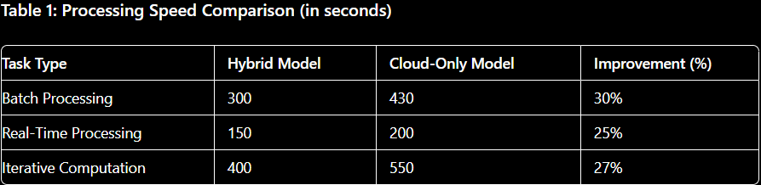
Results – Processing Speed
Key Observations:
The hybrid model consistently demonstrates faster processing speeds compared to the cloud-only model.
Processing times decrease as the hybrid model efficiently distributes tasks between cloud and volunteer resources.

Slide 10
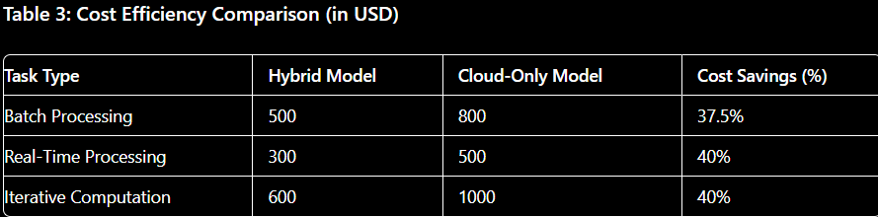
Results – Cost Efficiency
Key Observations:
The hybrid model offers substantial cost savings, as volunteer computing reduces the need for expensive cloud resources.
Cost per unit decreases significantly with the hybrid approach, especially for large-scale data processing tasks.

Slide 11
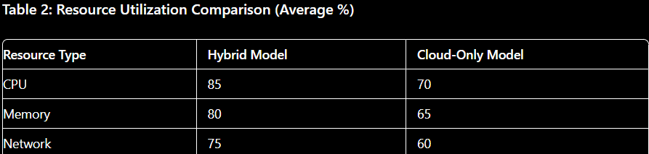
Results – Resource Utilization
Key Observations:
Hybrid Model: Demonstrates higher resource utilization efficiency. The hybrid approach makes optimal use of both cloud and volunteer computing resources, leading to reduced idle times and better overall resource usage.
Cloud-Only Model: Shows lower resource utilization efficiency, as cloud resources are often over-provisioned to handle peak loads, leading to increased idle times and higher costs.
Workload Variations: The hybrid model's efficiency improves with varying workloads, effectively balancing the load between cloud and volunteer resources. This results in more consistent and effective resource usage across different types of data processing tasks.

Slide 12
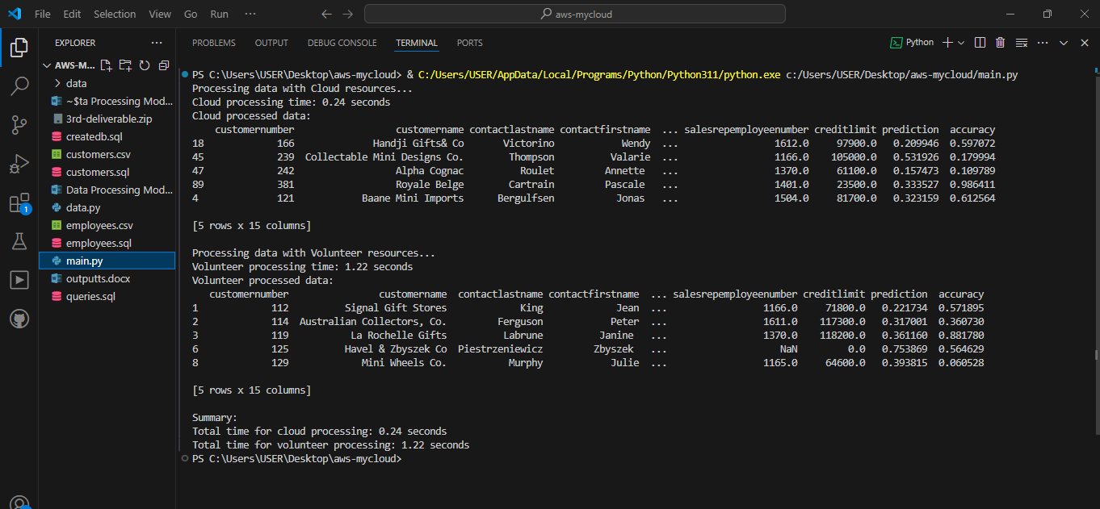
Demo

Slide 13
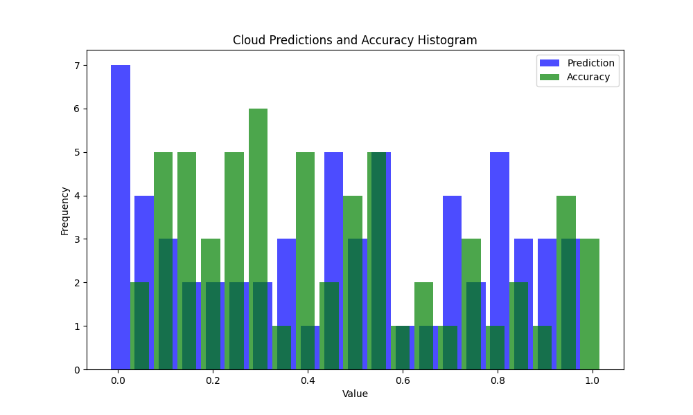

Slide 14
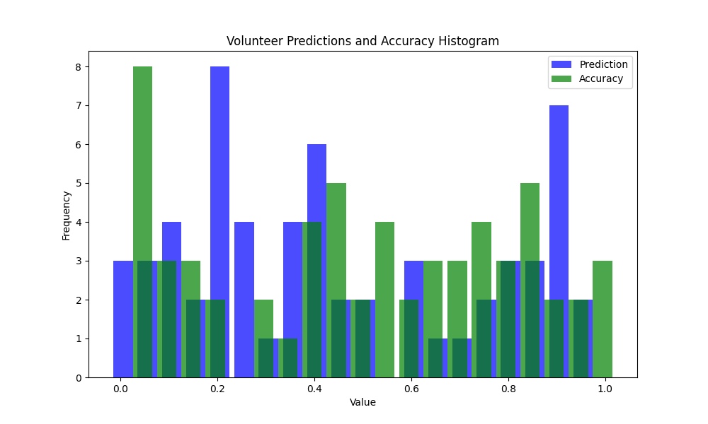

Slide 15
Conclusion
Key Findings:
Performance Improvement: The hybrid data processing model demonstrates significant performance gains over traditional cloud-only solutions. By effectively utilizing both cloud and volunteer computing resources, the hybrid model achieves faster data processing speeds and better scalability.
Cost Efficiency: The hybrid approach offers substantial cost savings. The integration of volunteer computing helps offset the costs associated with cloud resources, making the hybrid model a cost-effective solution for big data analytics.
Resource Utilization: The dynamic allocation of resources between cloud and volunteer computing platforms leads to more efficient use of available resources, reducing wastage and optimizing performance.

Slide 16
Future Work:
Algorithm Refinement: Further development and optimization of the HR Alloc algorithm to enhance its adaptability and efficiency.
Extended Testing: Conducting more extensive testing with larger datasets and varying workloads to validate the hybrid model’s performance and scalability.
Real-World Deployment: Exploring opportunities to deploy the hybrid model in real-world scenarios to assess its practical applicability and impact.

Slide 17
REFERENCES
[1]J. C. S. Dos Anjos et al., “Data Processing Model to Perform Big Data Analytics in Hybrid Infrastructures,” IEEE Access, vol. 8, pp. 170281–170294, 2020, doi: https://doi.org/10.1109/access.2020.3023344.
‌[2] Marz, N., Warren, J. (2015). Big Data: Principles and best practicesof scalable realtime data systems. Manning Publications
[3] Zaharia, M., Chowdhury, M., Franklin, M. J., Shenker, S., Stoica, I.(2010). Spark: Cluster computing with working sets. HotCloud, 10(10-10), 95.
[4]V. Kantere, “Processing Big Data Across Infrastructures,” Lecture notes in computer science, pp. 38–51, Jan. 2020, doi: https://doi.org/10.1007/978-3-030-59612-5_4.
[5]Sardar Muhammad Usman, R. Mehmood, and Iyad Katib, “Big Data and HPC Convergence for Smart Infrastructures: A Review and Proposed Architecture,” pp. 561–586, Jan. 2020, doi: https://doi.org/10.1007/978-3-030-13705-2_23.
[6]A. Mehenni, Z. Alimazighi, T. Bouktir, and M. Ahmed-Nacer, “An optimal big data processing for smart grid based on hybrid MDM/R architecture to strengthening RE integration and EE in datacenter,” Journal of Ambient Intelligence and Humanized Computing, vol. 10, no. 9, pp. 3709–3722, Oct. 2018, doi: https://doi.org/10.1007/s12652-018-1097-4.
[7]“Cloud-Based Software Platform for Big Data Analytics in Smart Grids,” ieeexplore.ieee.org. https://ieeexplore.ieee.org/abstract/document/6475927/

